Slide 1






VIRTUAL THERAPY
SESSION LOGGER
BY PRATAP MAHALINGAM

Slide 2
INTRODUCTION
Overview:
The Virtual Therapy Session Logger is a Python-based application designed to simplify the record-keeping process for therapists.
It provides a simple interface to
Patient Registration
Easily add, view, and manage patient details, including name, age, and contact information.
Session Management
Start and end therapy sessions seamlessly, log detailed session notes, and automatically track session duration.
Online Consultation Tracking
Record whether a session was conducted in-person or online, and log the platform used for online sessions (e.g., Zoom, Google Meet).
Session Scheduling
Plan and schedule future sessions with an integrated calendar and time input, including the option to specify platforms for online appointments.
Billing and Payment Tracking
Log session costs and monitor payment statuses (Paid, Pending, Overdue) to streamline financial management.
Session Rating and Feedback
Provide ratings (1-5) for each session and add optional feedback to evaluate and document session outcomes.
Session History Viewer
Review all past sessions for a selected patient, including details like session type, platform used, notes, ratings, and payment information.
Why is this project important?:
Organization: Therapists often struggle with manual record-keeping, which can be chaotic and time-consuming. This app ensures all session details are stored neatly in one place.
Focus on Patients: By automating administrative tasks, therapists can spend more time focusing on patient care and less time managing records.

Slide 3
LONG-TERM GOAL AND MAJOR APPLICATIONS
Long-term Goal:
Develop a scalable and intelligent therapy management system that:
Provides full integration with telehealth platforms to support remote consultations seamlessly.
Introduces AI-powered analytics to track patient progress, predict outcomes, and recommend tailored treatment plans.
Supports multi-user and multi-clinic environments, allowing teams of therapists to collaborate and manage shared patient records.
Includes real-time notifications for session reminders, overdue payments, and therapy milestones.
Facilitates compliance with global data protection regulations (e.g., HIPAA, GDPR) through advanced encryption and secure data handling.
Major Applications:
Large Clinics and Telehealth Platforms:
Enable centralized management of patient data and therapist schedules across multiple locations.
Integrate video conferencing and secure messaging for streamlined online therapy.
Therapist Networks and Organizations:
Allow team-based workflows where multiple therapists can manage shared patients.
Provide performance insights and usage analytics for organizations to monitor progress and optimize services.
Mental Health Research:
Use anonymized session data for research purposes, helping identify treatment trends and improving care strategies.
Provide longitudinal insights to track the effectiveness of therapy over time.
Personalized Therapy Solutions:
Offer automated suggestions and feedback to therapists using AI-driven recommendations based on patient history and feedback.

Slide 4
KEY FUNCTIONS AND MODULES
Add and Save Patients:
What It Does: Allows therapists to register patients by entering their name, age, and contact details.
How It Works: Stores patient data securely in the SQLite database for future reference.
Log Therapy Sessions:
What It Does: Tracks session start and stop times automatically and calculates durations.
How It Works: Uses the datetime module to automate time calculations and logs the details in the database.
Save and Review Session Notes:
What It Does: Enables therapists to write and save session-specific notes.
How It Works: Stores notes in the SQLite database, linked to each session, and provides a feature to retrieve and display them.
Track Online Consultations:
What It Does: Records whether a session is in-person or online and logs the platform used for online consultations.
How It Works: Captures session type and platform details as part of session data in the database.
Schedule Future Sessions:
What It Does: Allows therapists to schedule appointments using a calendar and specify session times and platforms.
How It Works: Uses the Tkcalendar module to select dates and stores scheduled sessions in the SQLite database.
Billing and Payment Tracking:
What It Does: Logs session costs and tracks payment statuses (Paid, Pending, Overdue).
How It Works: Stores billing details in the database and displays them with session history for easy financial tracking.
Session Ratings and Feedback:
What It Does: Lets therapists rate sessions (1-5) and add feedback for evaluation.
How It Works: Stores ratings and feedback alongside session details in the SQLite database, viewable in session history.

Slide 5
KEY FUNCTIONS AND MODULES
SQLite:
Purpose: Stores all patient and session information, including billing and feedback.
Why It’s Important: Keeps data safe, organized, and accessible, even after the app is closed.
Datetime:
Purpose: Tracks session durations and schedules future appointments.
Why It’s Important: Ensures accurate time tracking and simplifies appointment scheduling.
Tkinter:
Purpose: Provides the app's user interface.
Why It’s Important: Makes the app easy to use with intuitive buttons, dropdowns, and input fields.
Tkcalendar :
Purpose: Adds a calendar for scheduling sessions.
Why It’s Important: Simplifies picking dates for future appointments.
Billing and Ratings Logic :
Purpose: Tracks payments and session ratings.
Why It’s Important: Helps therapists manage finances and evaluate session quality.

Slide 6
CHALLENGES
1. Designing an Intuitive Interface
Challenge: Ensuring the GUI is simple and user-friendly for therapists who may not be tech-savvy.
Solution: Used Tkinter to implement dropdowns, buttons, and text fields that are easy to navigate.
2. Managing Data Efficiently
Challenge: Ensuring SQLite can store and retrieve large amounts of patient and session data without delays.
Solution: Structured SQL queries and database indexing for optimal performance.
3. Accurate Time Tracking
Challenge: Ensuring session start and end times are recorded and durations are calculated precisely.
Solution: Used datetime to handle time differences and automate calculations.
4. Scheduling Future Appointments
Challenge: Allowing therapists to schedule sessions easily while ensuring time and date inputs are accurate.
Solution: Integrated Tkcalendar for date selection and a separate field for precise time entry.
5. Tracking Online Consultations
Challenge: Capturing session type (in-person or online) and platform details for online sessions.
Solution: Added dropdown menus for session type and platform, dynamically saving the input to the database.
6. Handling Billing and Payment Tracking
Challenge: Logging session costs and tracking payment statuses without data inconsistencies.
Solution: Implemented dropdowns for predefined payment statuses and validated cost inputs for accuracy.
7. Collecting Ratings and Feedback
Challenge: Simplifying the process of adding ratings and feedback without cluttering the interface.
Solution: Added a Spinbox for session ratings (1-5) and a text area for feedback, linked to session data storage.

Slide 7

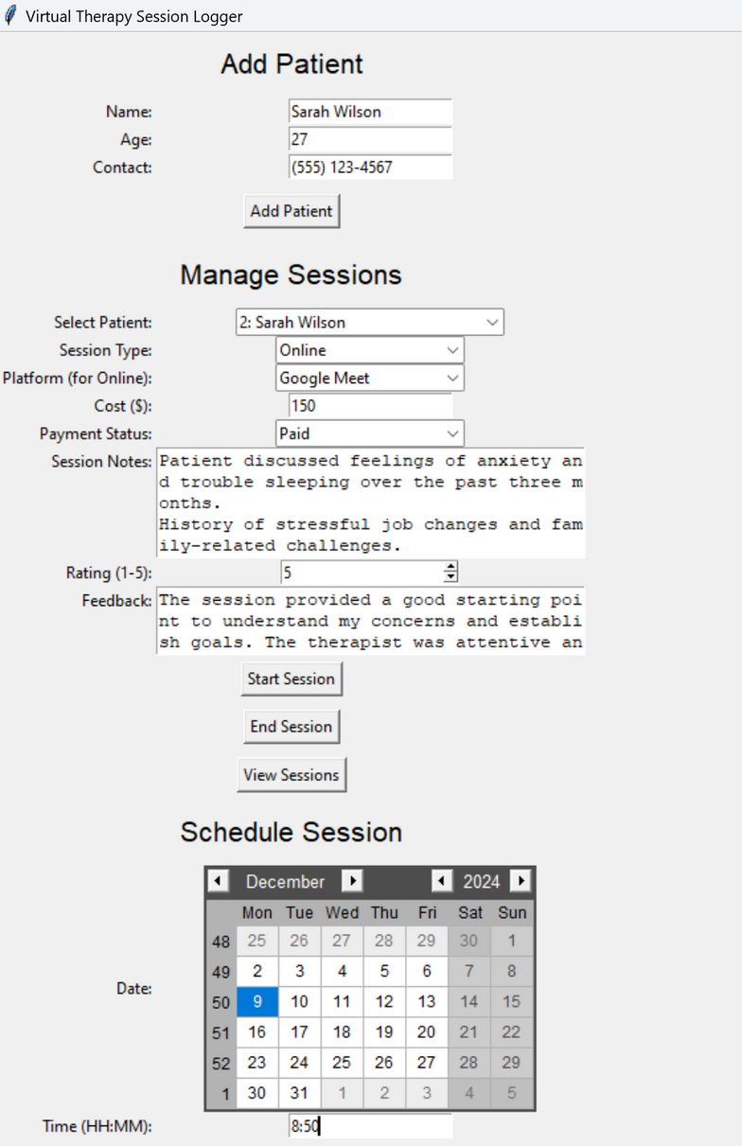





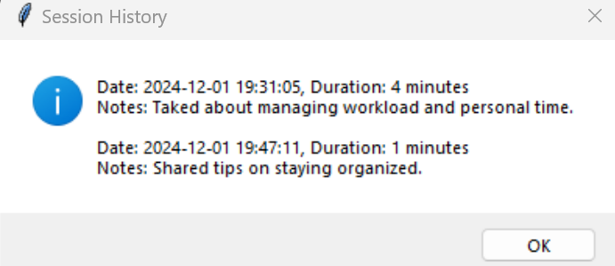

OUTPUT

